Slide 1

ECLAT Algorithm
Betül salt
Veri Madenciliği Teknikleri
FATİH SULTAN MEHMET VAKIF ÜNİVERSİTESİ

Slide 2
What is ECLAT Algorithm?
Equivalence Class Clustering and bottom-up Lattice Traversal
ECLAT is one of the frequent pattern mining techniques
FPM aims to find statistically relevant patterns in data
It tries to find longest combination of elements with a frequency above a threshold

Slide 3
Eclat Algorithm was proposed by ZAKI in 2000
It is one of the popular methods of Association Rule mining
The algorithm works in a vertical manner like the Depth-First Search of a graph
Vertical approach makes the algorithm faster
It is a more efficient and scalable version of the Apriori algorithm

Slide 4
How the algorithm works?
Use Transaction Id Sets(tidsets) intersections to compute the support value of a candidate
In the first call of the function, all single items are used along with their tidsets
Then the function is called recursively
In each recursive call, each item-tidset pair is verified
This process is continued until no candidate item-tidset pairs can be combined

Slide 5
Support = Frequency ( X, Y ) / N
Confidence = Frequency ( X, Y ) / Frequency ( X )

Slide 6
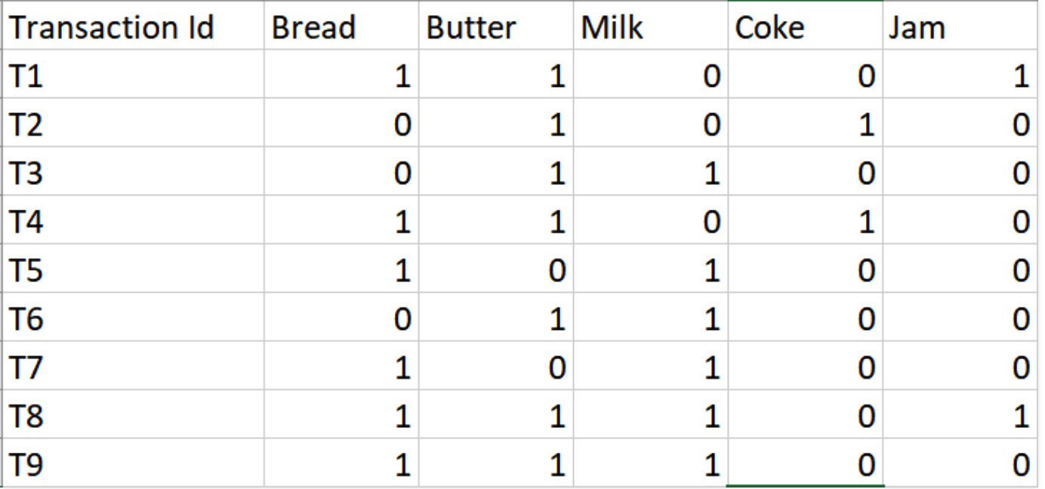
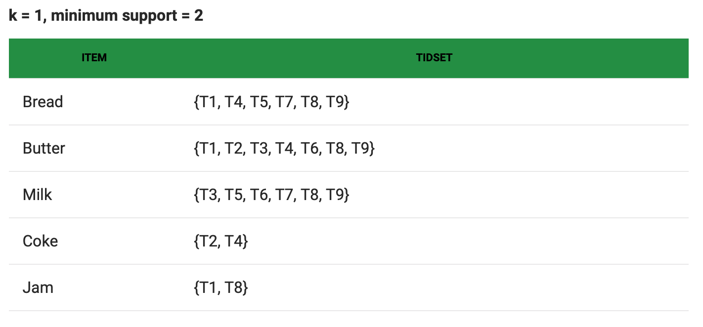

Slide 7
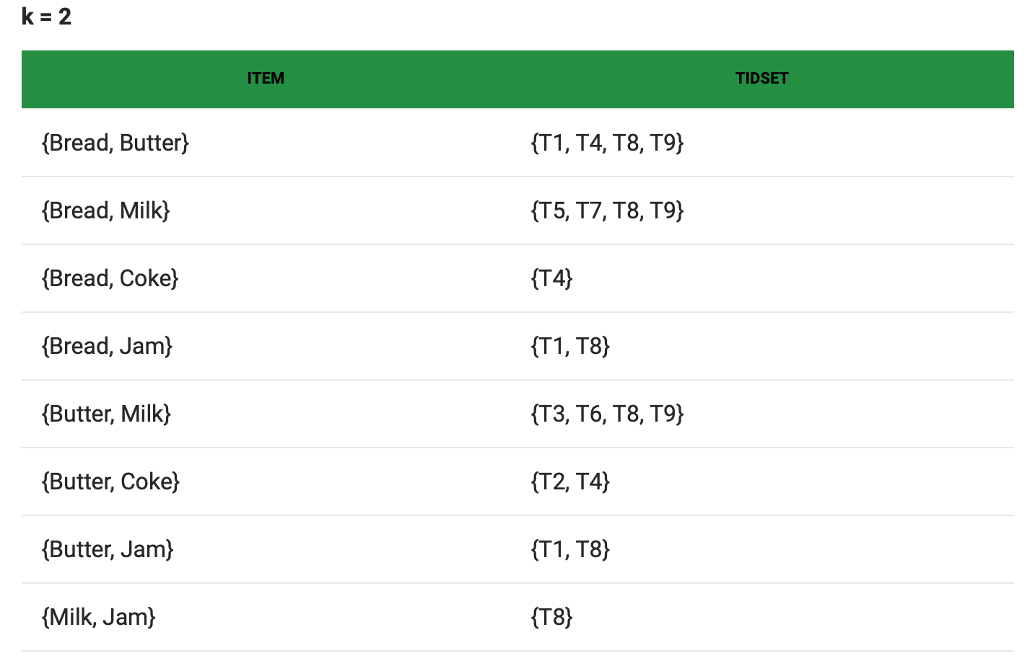

Slide 8
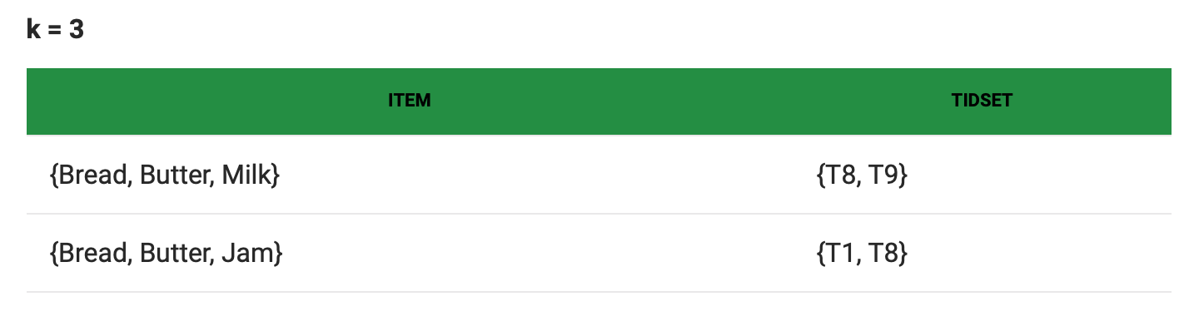
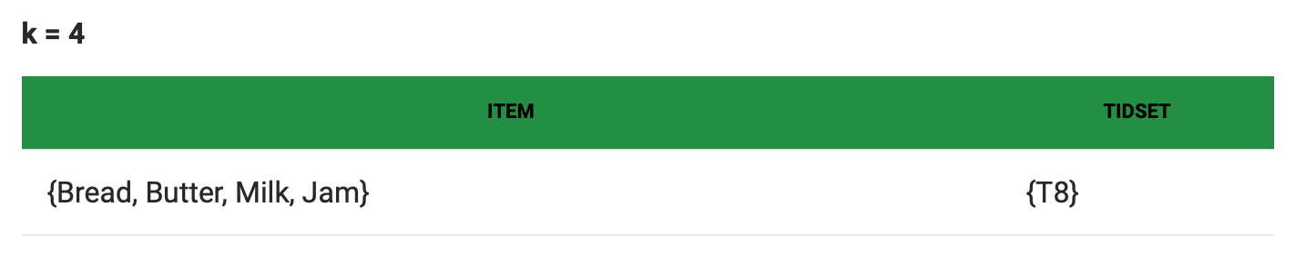

Slide 9
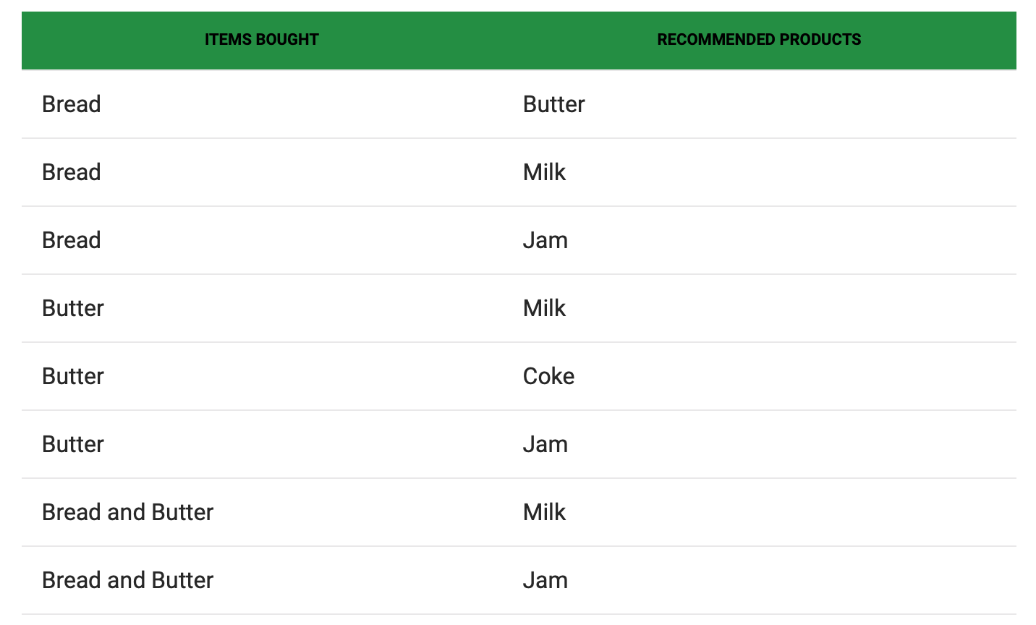

Slide 10
Advantages:
Memory Requirements: Since uses a Depth-First Search approach, it uses less memory
Speed: fast
Number of Computations: does not involve the repeated scanning of the data to compute the individual support values

Slide 11
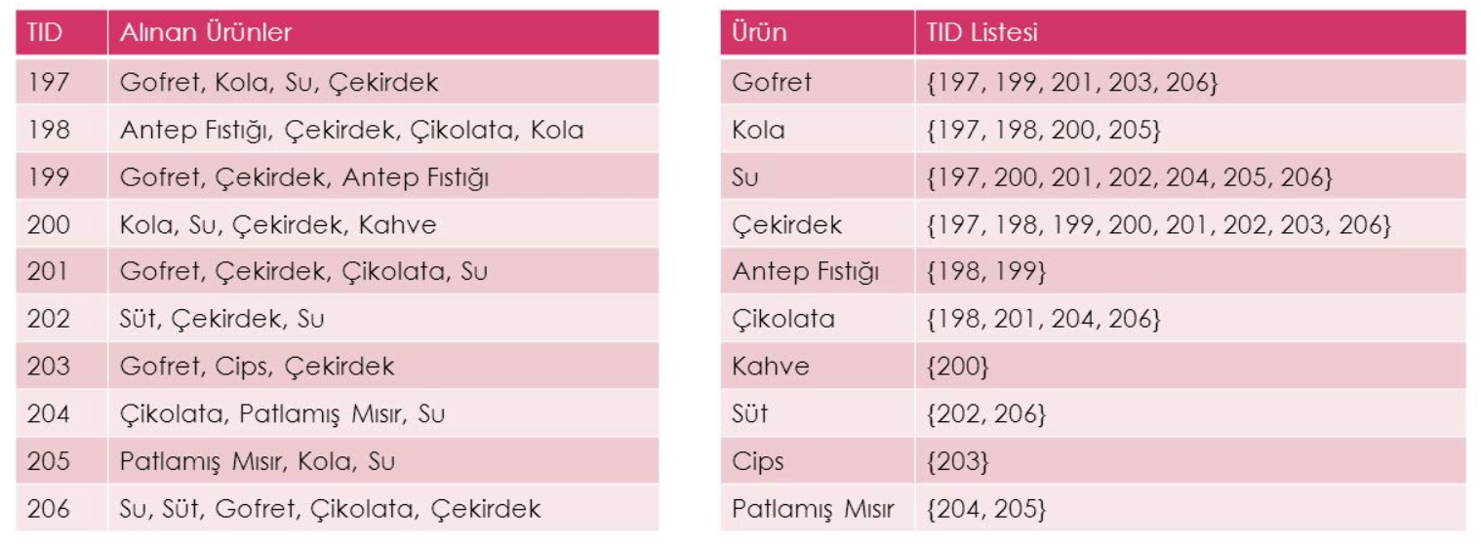
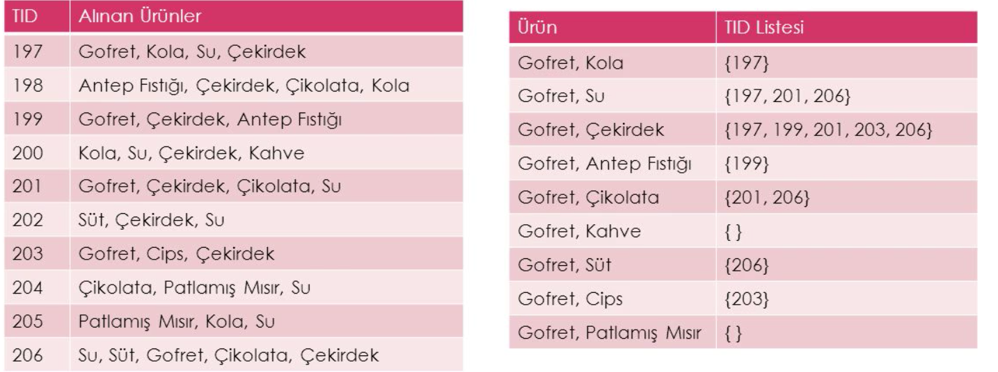

Slide 12
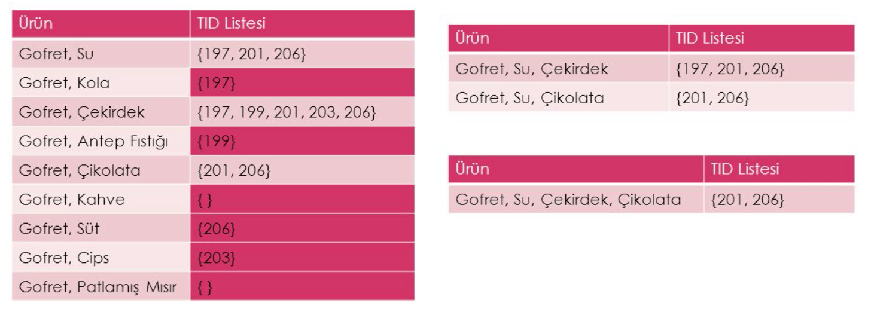

Slide 13
